Slide 1
Machine Learning
Introduction to Clustering

Slide 2
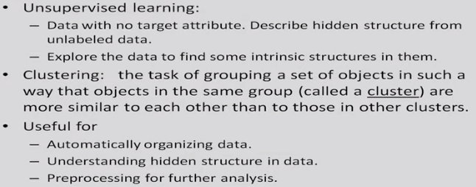
Unsupervised learning

Slide 3
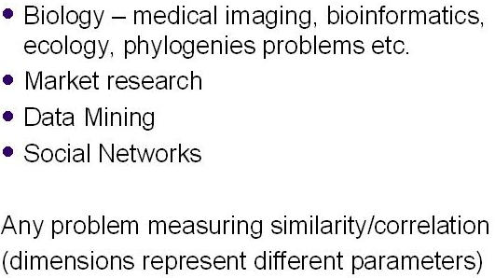
Applications of clustering
ias.ac.in

Slide 4
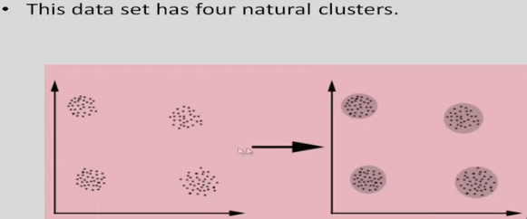
Example
Dr. Sudeshna Sarkar, IIT Kharagpur

Slide 5
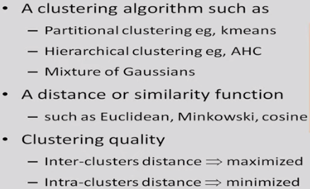
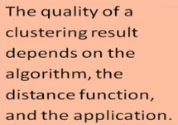
Aspects of clustering
Dr. Sudeshna Sarkar, IIT Kharagpur

Slide 6
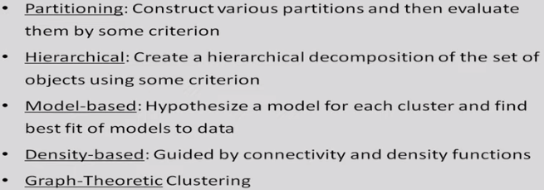
Major clustering approaches
Dr. Sudeshna Sarkar, IIT Kharagpur

Slide 7
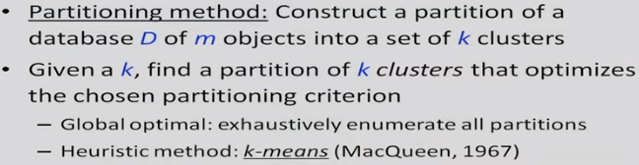
Partitioning algorithms
Dr. Sudeshna Sarkar, IIT Kharagpur

Slide 8
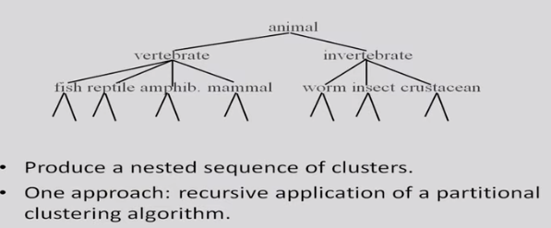
Hierarchical clustering
Dr. Sudeshna Sarkar, IIT Kharagpur

Slide 9
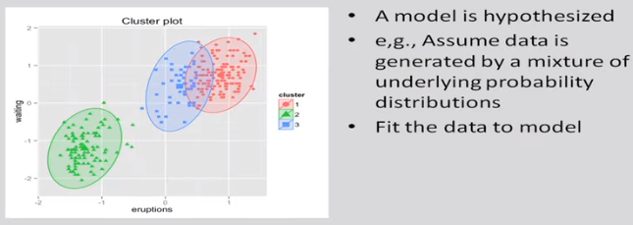
Model based clustering
Dr. Sudeshna Sarkar, IIT Kharagpur

Slide 10
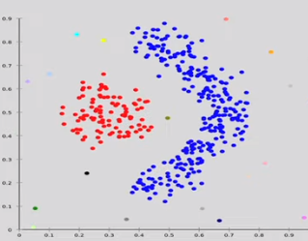
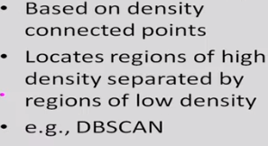
Density based clustering
Dr. Sudeshna Sarkar, IIT Kharagpur

Slide 11
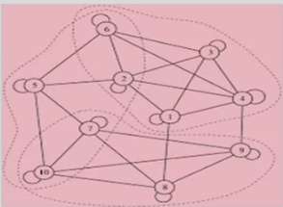
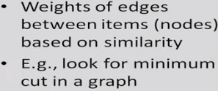
Graph-theoretic clustering
Dr. Sudeshna Sarkar, IIT Kharagpur

Slide 12
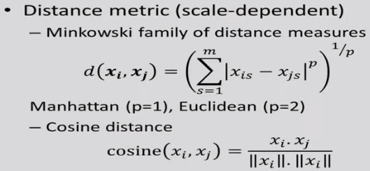
(Dis)Similarity measures
Dr. Sudeshna Sarkar, IIT Kharagpur

Slide 13

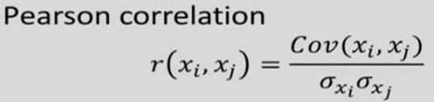
(Dis)Similarity measures
Mahalanobis distance

Slide 14
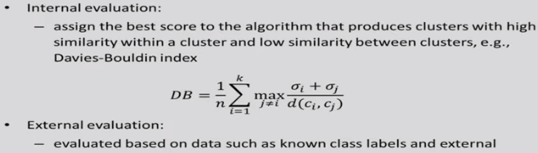
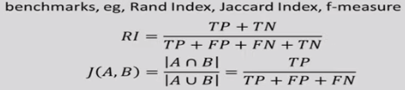
Quality of clustering
Dr. Sudeshna Sarkar, IIT Kharagpur

